Slide 1
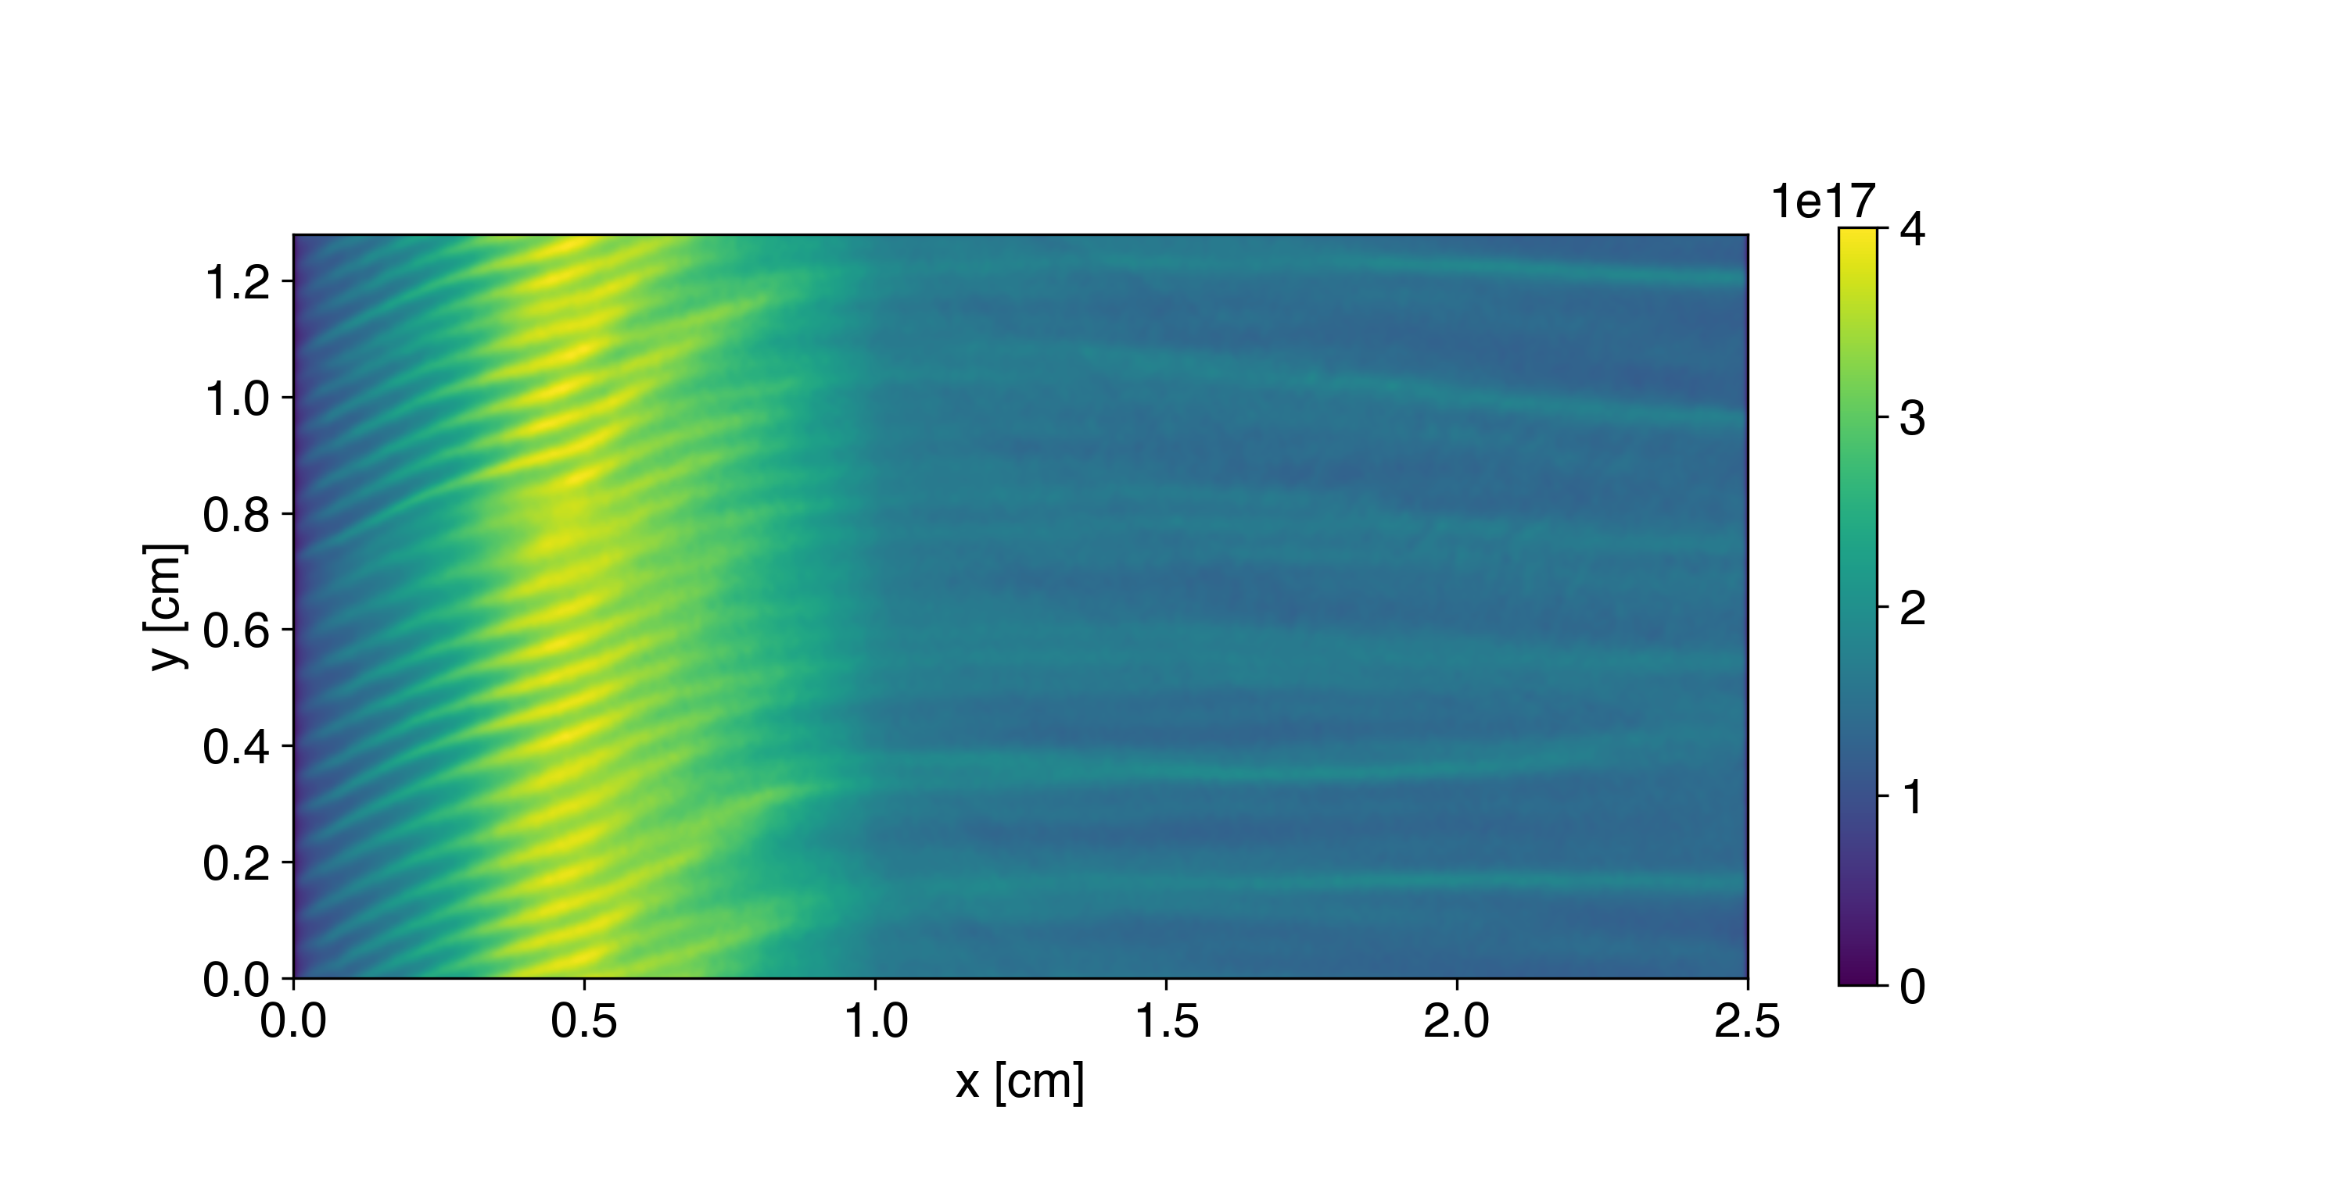
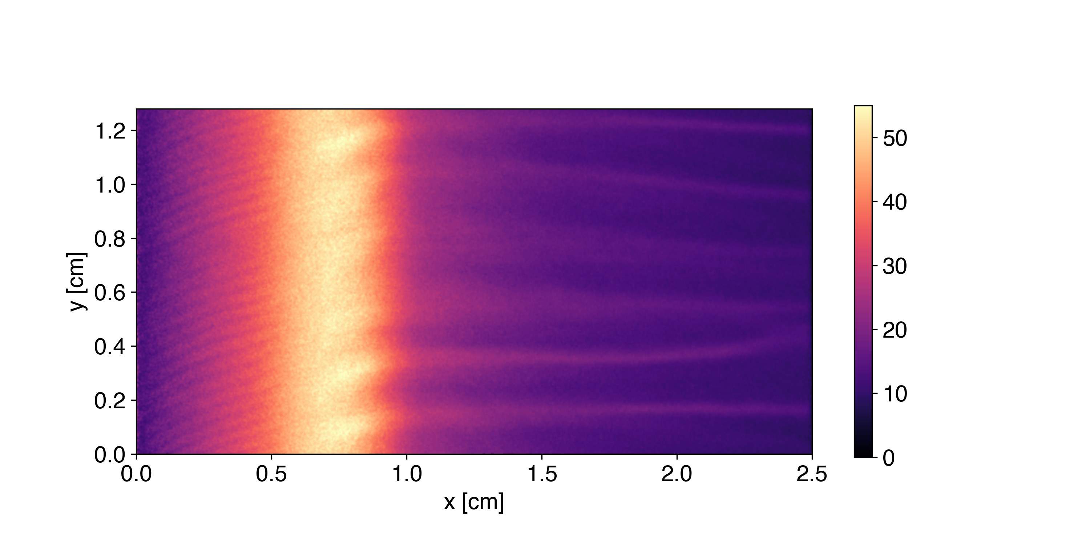


Hall thruster simulations in WarpX
Thomas A. Marks
Alex A. Gorodetsky
University of Michigan, Ann Arbor, Michigan, USA

Slide 2
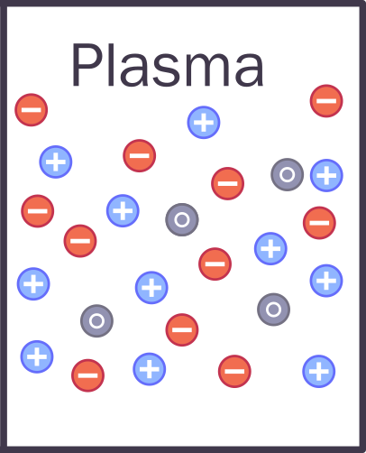
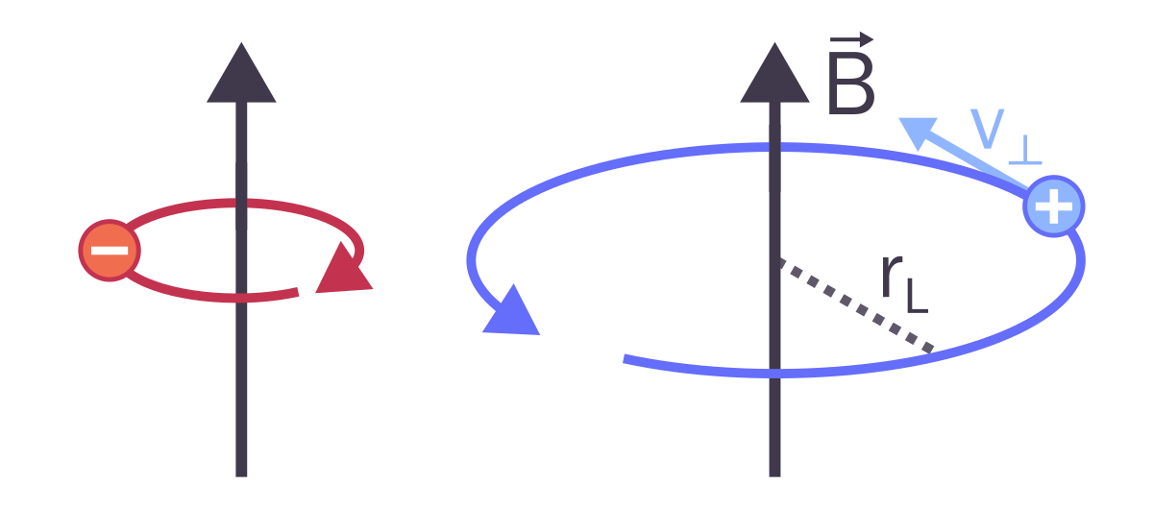
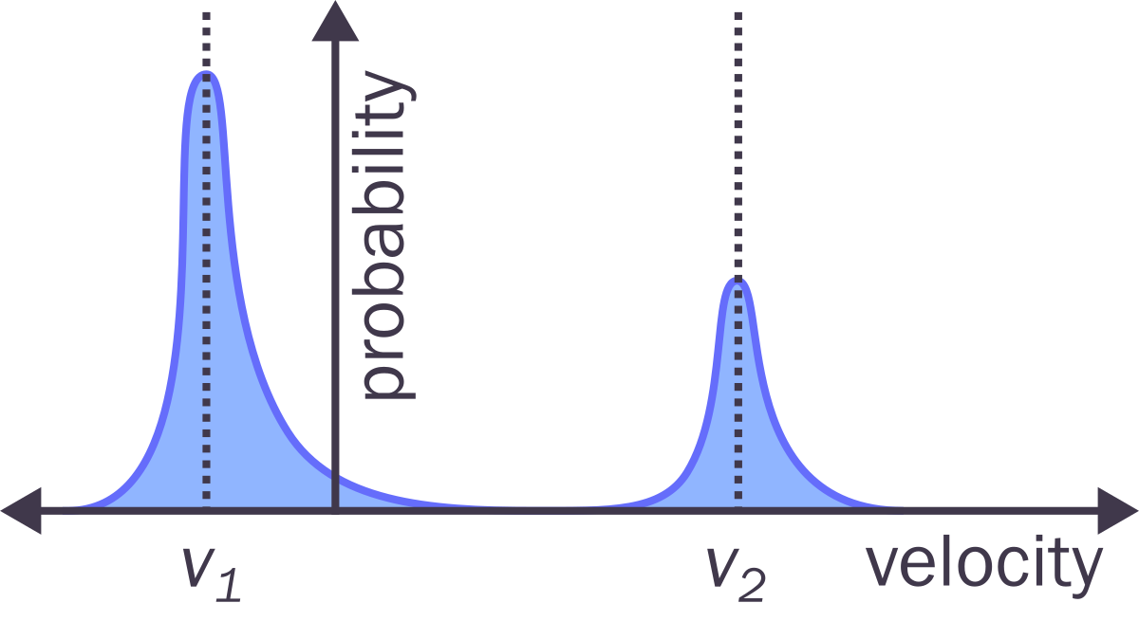
Motivation - Kinetic simulations
Fluid simulations unable to capture anomalous electron transport and many other electron-scale phenomena
Kinetic simulations resolve full VDF and can self-consistently predict enhanced transport
Must resolve Debye length and plasma frequency – extremely expensive!

Slide 3
GPU vs CPU
CPUS: fast but can’t do much in parallel (2-8 cores, typically)
GPUS: slower individual cores but thousands of them
RAM
VRAM
Cache
Cache
Core
Core
Core
Cache
Core
Core
Core
Cache
Cache

Slide 4
GPU vs CPU
CPUS: fast but can’t do much in parallel (2-8 cores, typically)
GPUS: slower individual cores but thousands of them
RAM
VRAM
Ideal for particle simulations
Cache
Cache
Core
Core
Core
Cache
Core
Core
Core
Cache
Cache

Slide 5
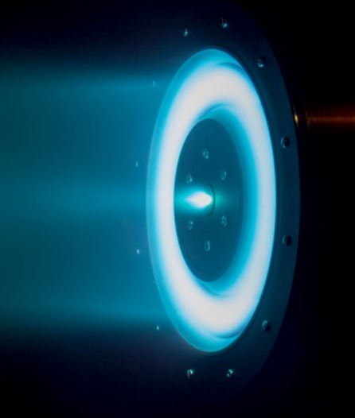
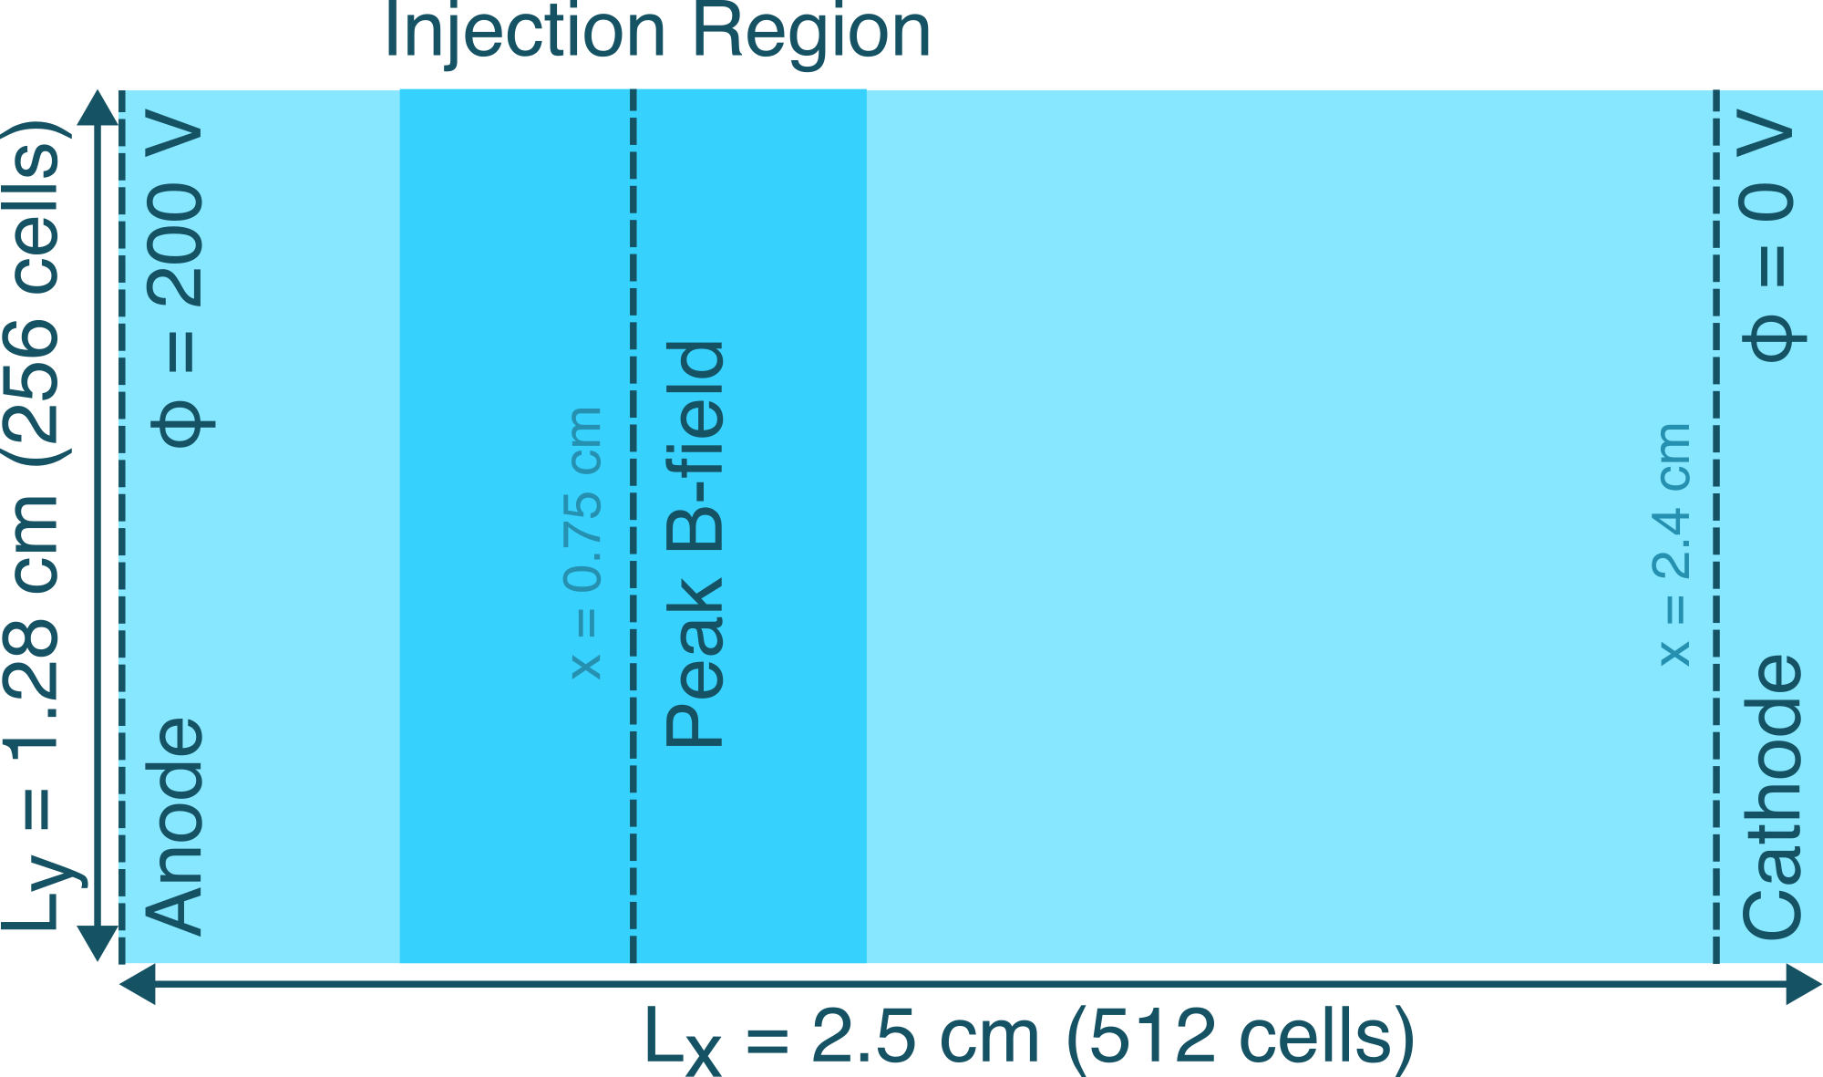
LANDMARK benchmark
Setup: 2D axial-azimuthal simulation
No neutral dynamics – artificial ionization source term
Simulate 20 microseconds of thruster operation
y
x

Slide 6
LANDMARK benchmark
y
Setup: 2D axial-azimuthal simulation
No neutral dynamics – artificial ionization source term
Simulate 20 microseconds of thruster operation
x
Particle-in-cell treatment of both electrons and ions
Grid size ~ Debye length
50 um
Time step ~ plasma frequency
5 x 10⁻¹² seconds
2 million timesteps
512 x 256 cells

Slide 7
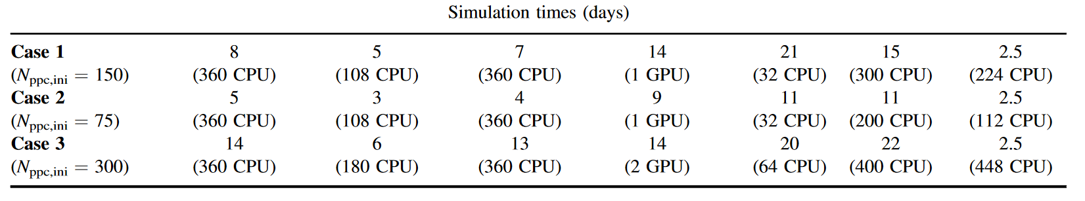
LANDMARK benchmark
Setup: 2D axial-azimuthal simulation
No neutral dynamics – artificial ionization source term
Simulate 20 microseconds of thruster operation
T Charoy et al 2019 Plasma Sources Sci. Technol. 28 105010

Slide 8
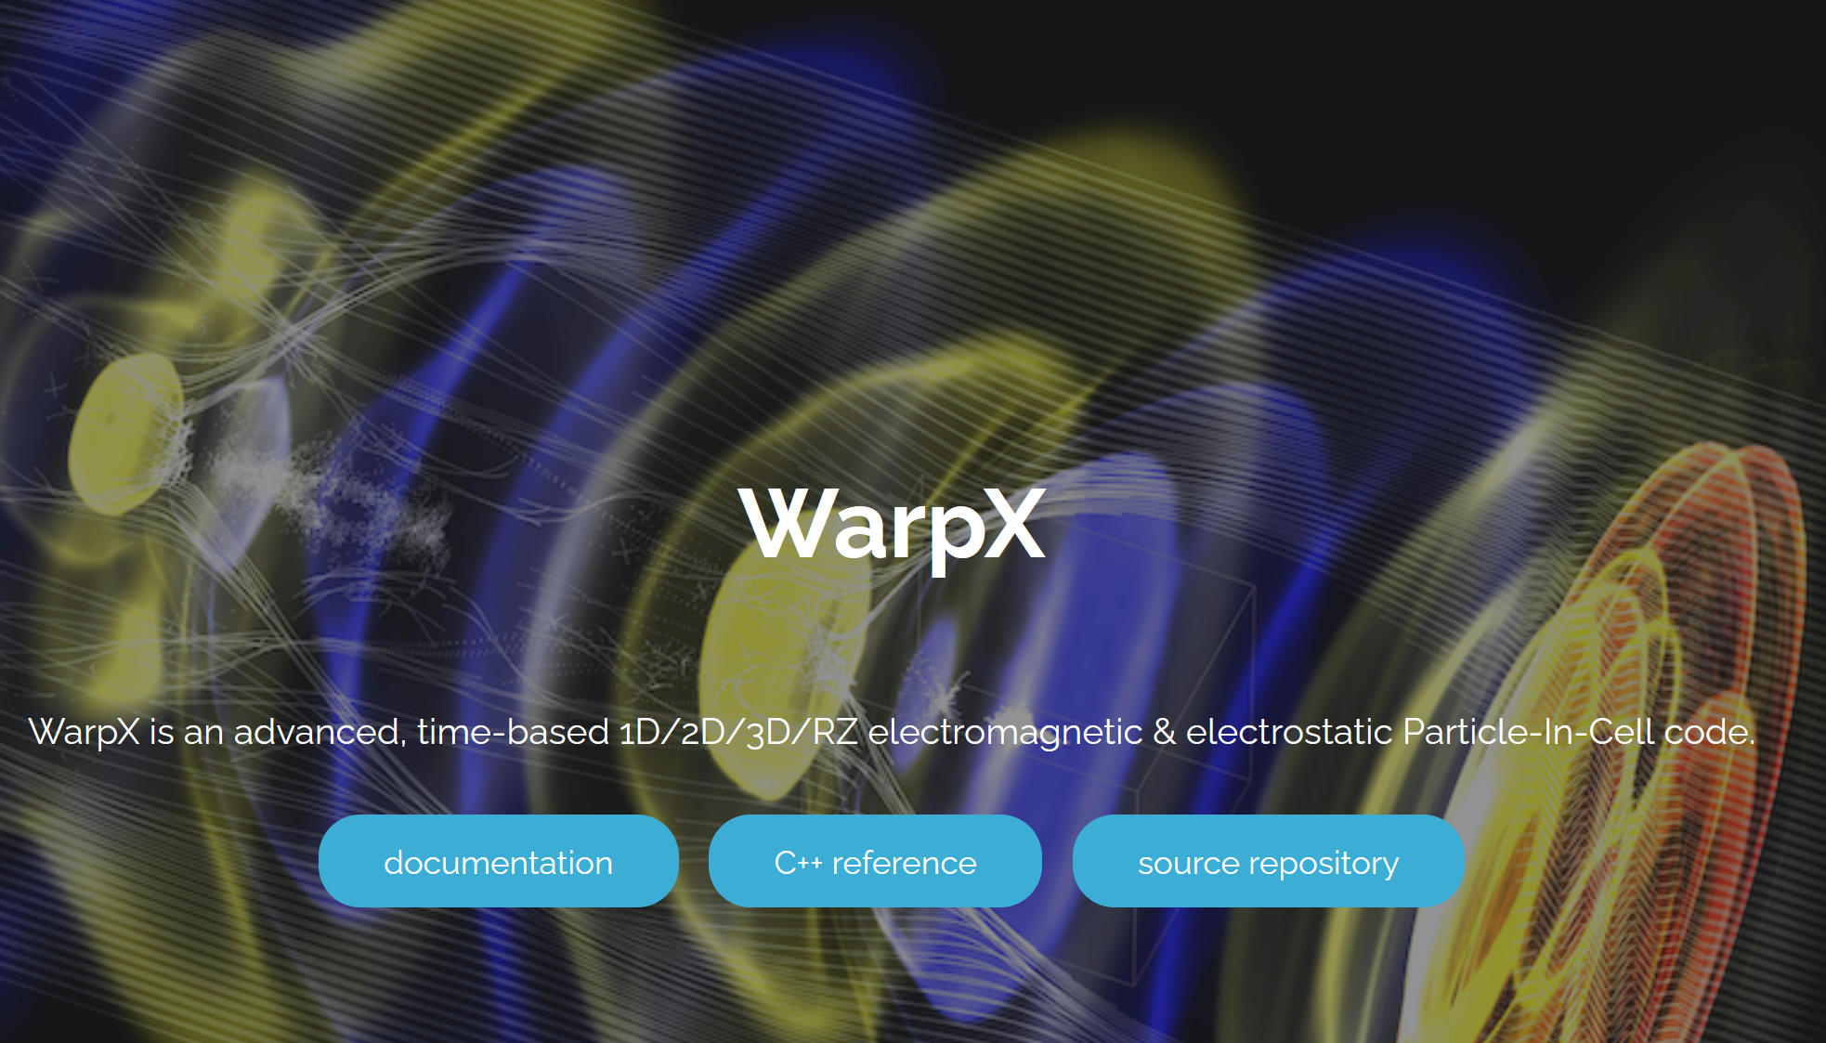
Our tool - WarpX
Designed to scale to largest clusters
CPU and GPU
Designed for laser-plasma interactions, but extendable to other regimes
Modified for Hall thruster simulations
(Python callbacks)
https://ecp-warpx.github.io/

Slide 9
Modifications for Hall thruster simulations

Slide 10
Modifications for Hall thruster simulations
1. Volumetric source term – inject electron-ion pairs to mimic ionization
+
+
-
-
-
+
-
-
+
+

Slide 11
Modifications for Hall thruster simulations
2. Cathode – inject electrons to maintain current continity
-
-
-
-

Slide 12
Modifications for Hall thruster simulations
3. Cathode – modify potential to get 0 V at cathode line

Slide 13
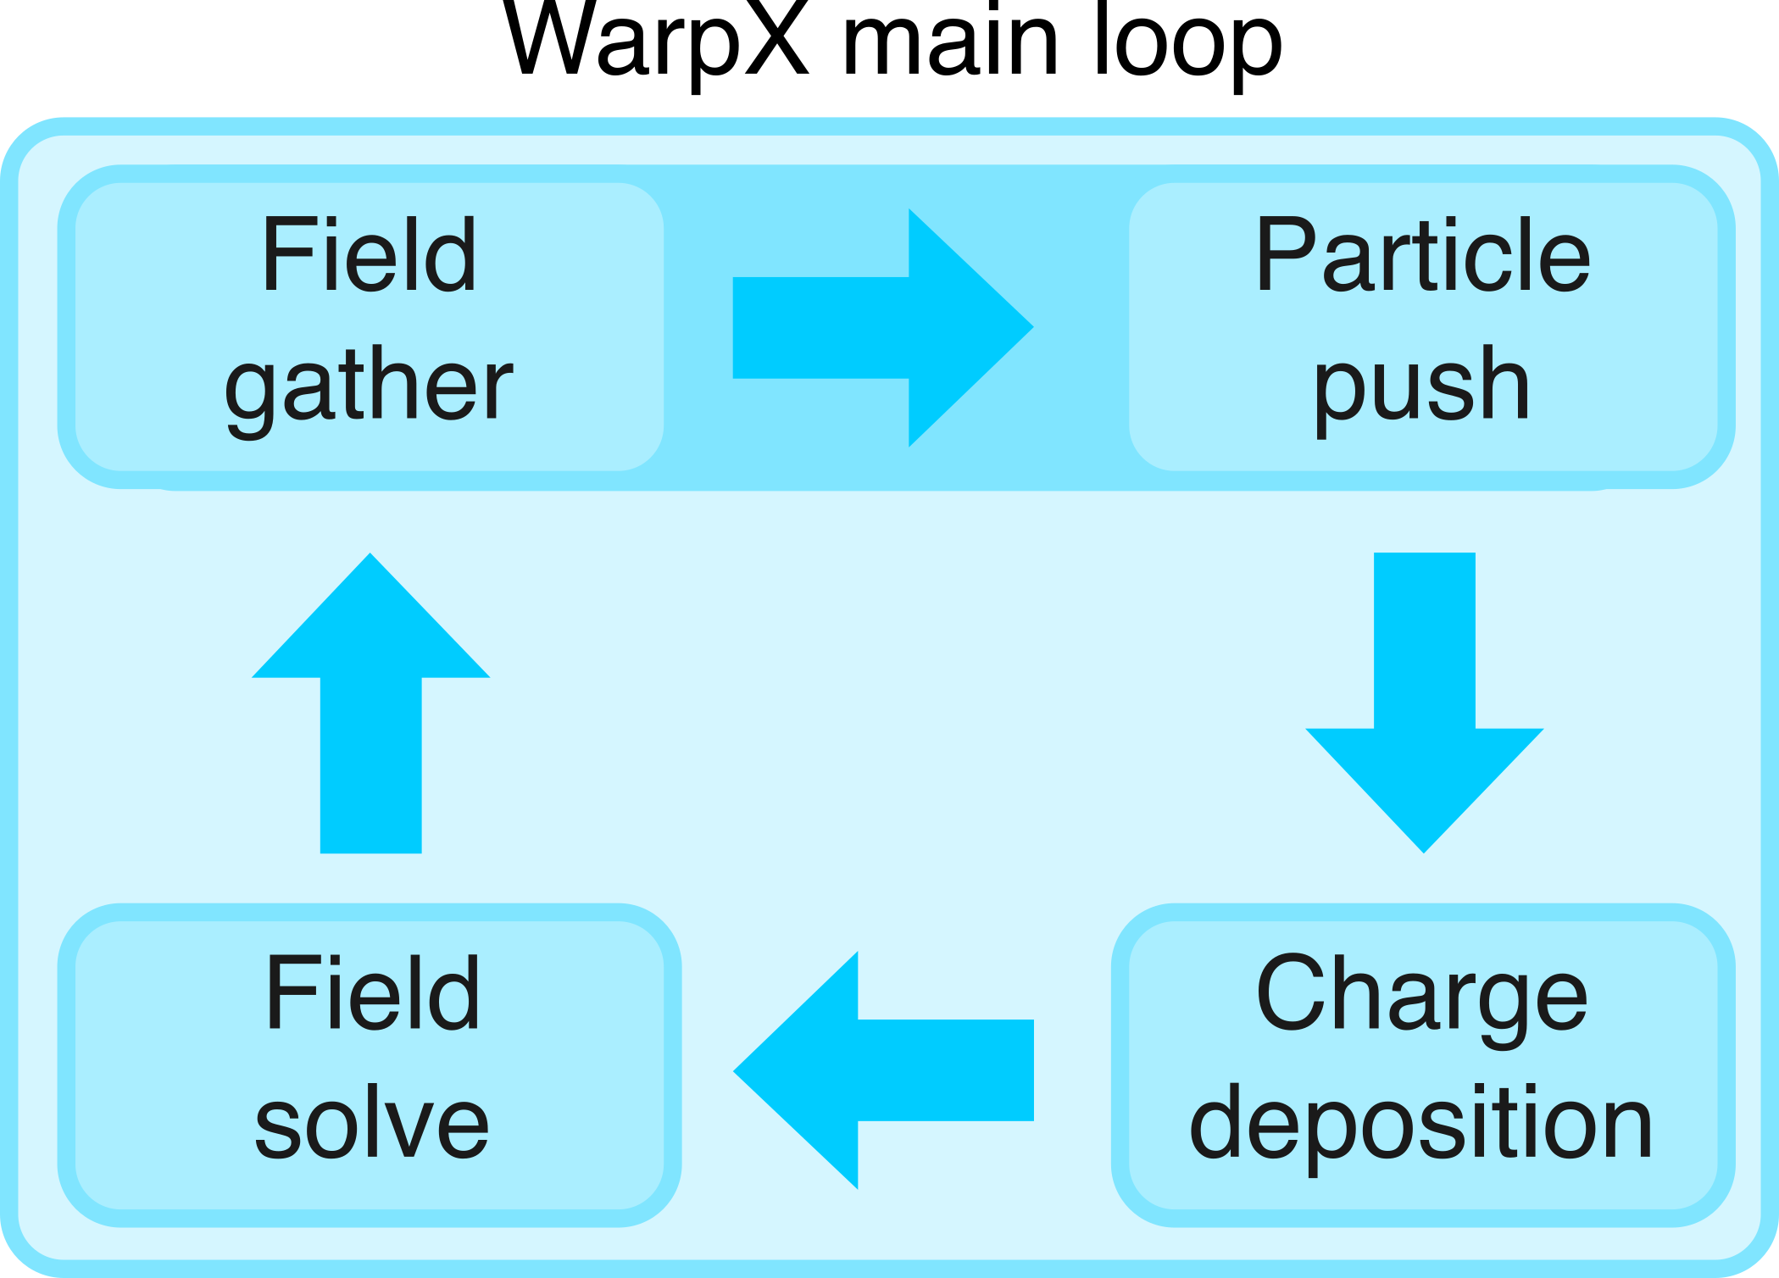
Modifications for Hall thruster simulations

Slide 14
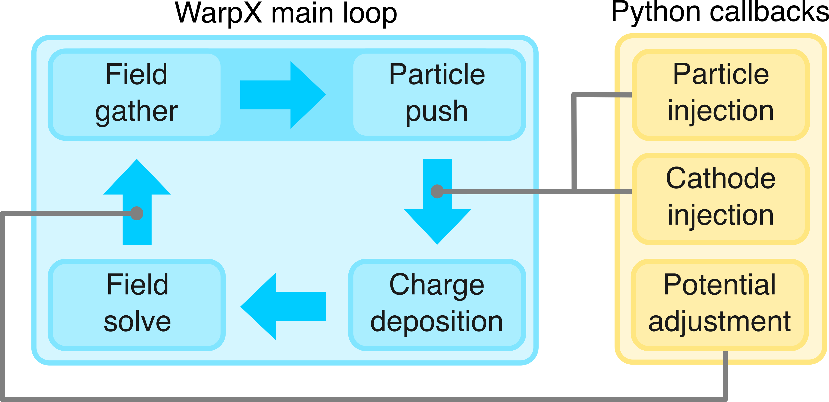
Modifications for Hall thruster simulations

Slide 15
Modifications for Hall thruster simulations
(Less than 100 lines of code)

Slide 16
GPU choices

Slide 17
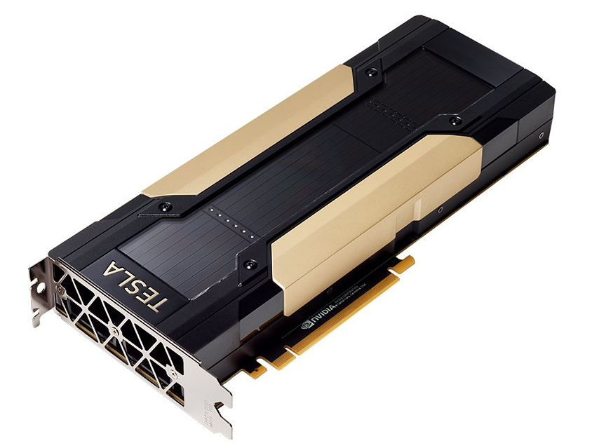
GPU choices
NVIDIA V100

Slide 18
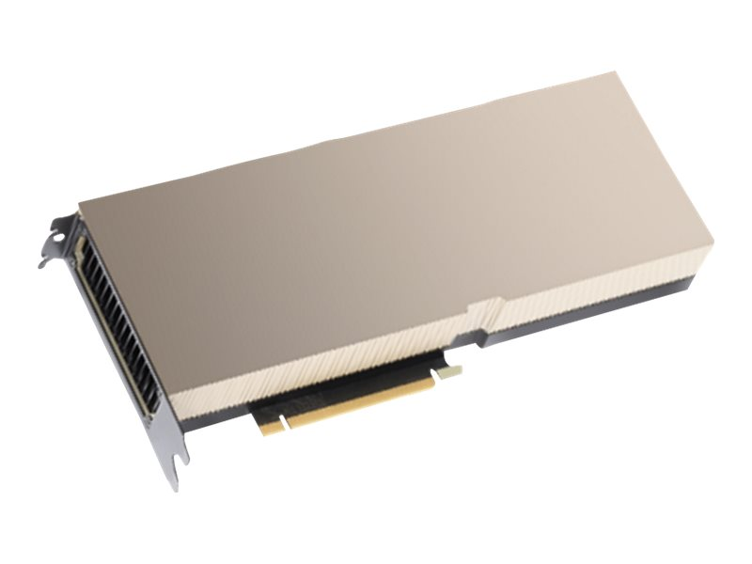
GPU choices
NVIDIA V100
NVIDIA H100

Slide 19
GPU choices
NVIDIA V100
NVIDIA H100
Released 2017
32 GB memory
7 TFLOPS double precision
14 TFLOPS single precision

Slide 20
GPU choices
NVIDIA V100
NVIDIA H100
Released 2017
32 GB memory
7 TFLOPS double precision
14 TFLOPS single precision
Released 2022
80 GB memory
26 TFLOPS double precision
51 TFLOPS single precision

Slide 21
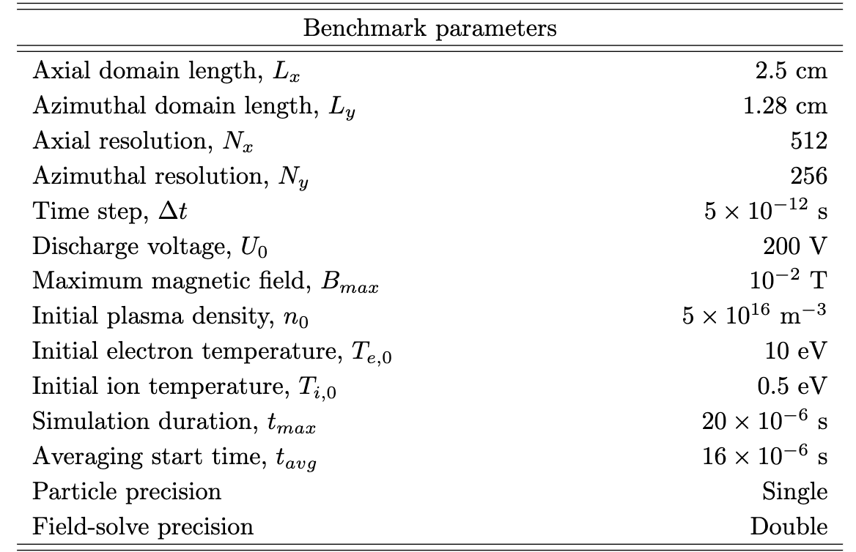
Other benchmark conditions
Case 2 (75 ppc initial) as baseline
Single precision arithmetic for particles, double-precision for fields
Present results averaged over y (azimuthal) direction from the interval 16-20 us

Slide 22
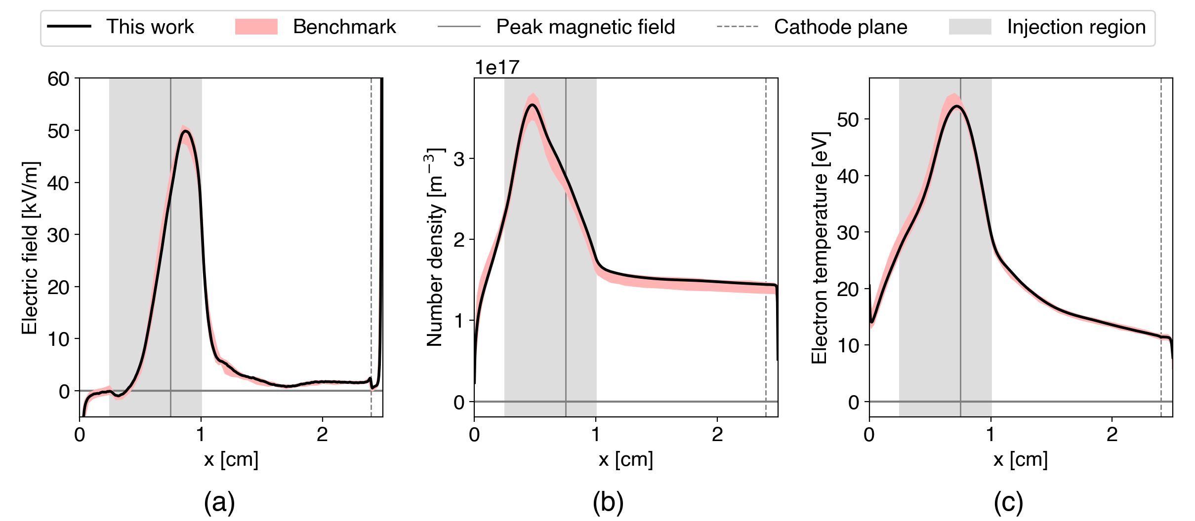
Our benchmark results

Slide 23
Our benchmark results

Slide 24
Our benchmark results

Slide 25
Our benchmark results
WarpX can simulate Hall thrusters!

Slide 26
Performance

Slide 27
Performance
Our results: V100: 3.8 days H100: 1.8 days

Slide 28
Performance
Can we do better?
Our results: V100: 3.8 days H100: 1.8 days

Slide 29
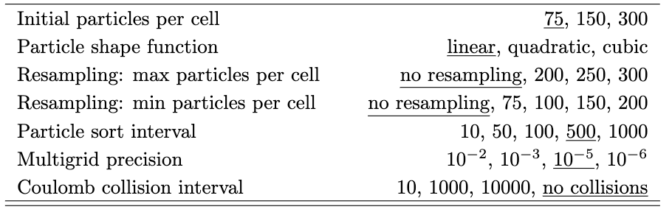
Numerical parameter investigation
Investigated impact of many numerical parameters on results and performance

Slide 30
Numerical parameter investigation
Focus here on particle down-sampling and field solve precision

Slide 31
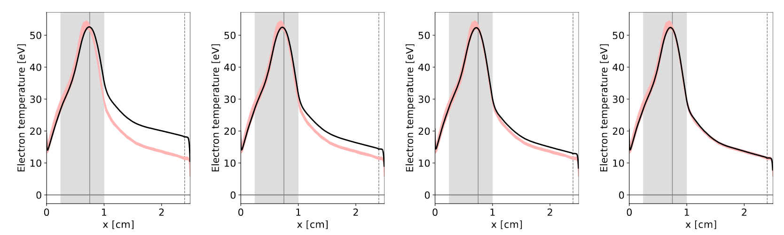
Resampling
Particle down-sampling accelerates simulation but introduces artificial broadening of the VDF in low-temperature regions
200 particles/cell
250 particles/cell
275 particles/cell
300 particles/cell
1.4 days
1.5 days
1.65 days
1.75 days

Slide 32
Resampling
Particle down-sampling accelerates simulation but introduces artificial broadening of the VDF in low-temperature regions
200 particles/cell
250 particles/cell
275 particles/cell
300 particles/cell
1.4 days
1.5 days
1.65 days
1.75 days

Slide 33
Resampling
Particle down-sampling accelerates simulation but introduces artificial broadening of the VDF in low-temperature regions
200 particles/cell
250 particles/cell
275 particles/cell
300 particles/cell
1.4 days
1.5 days
1.65 days
1.75 days

Slide 34
Resampling
Particle down-sampling accelerates simulation but introduces artificial broadening of the VDF in low-temperature regions
200 particles/cell
250 particles/cell
275 particles/cell
300 particles/cell
1.4 days
1.5 days
1.65 days
1.75 days

Slide 35
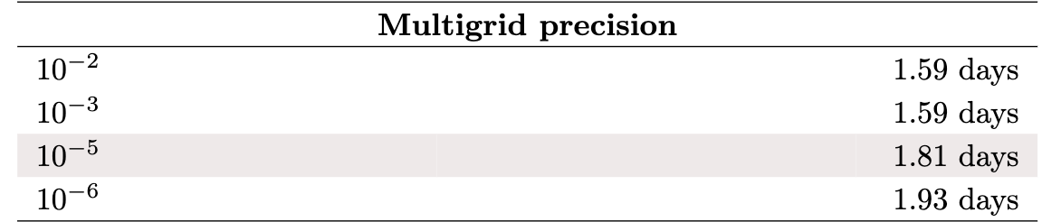
Field solve precision
Field is solved iteratively until a specified tolerance is reached
Vary tolerance between 1e-2 and 1e-6
No observable difference in results, but a significant speedup
2 iterations
3 iterations
4 iterations

Slide 36
Optimized simulation
Combining results of parameter studies, employ best-found options to perform fastest simulation
Larger field solve tolerance
Increased particle sorting frequency
Resampling only above 300 ppc
Final time:
36 hours

Slide 37
Future work
Multiple GPUs
WarpX’s demonstrated scaling abilities suggests we should be able to tackle much larger problems (3D, larger domains) efficiently by employing many GPUS

Slide 38
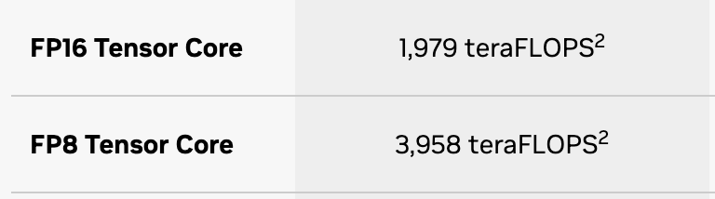
Future work
Better use of tensor and reduced-precision capabilities
These GPUs are heavily optimized for machine learning workloads
https://www.nvidia.com/en-us/data-center/h100/
NVIDIA H100
Released 2022
80 GB memory
26 TFLOPS double precision
51 TFLOPS single precision
Can parts of the PIC algorithm be made to work with these operations?

Slide 39
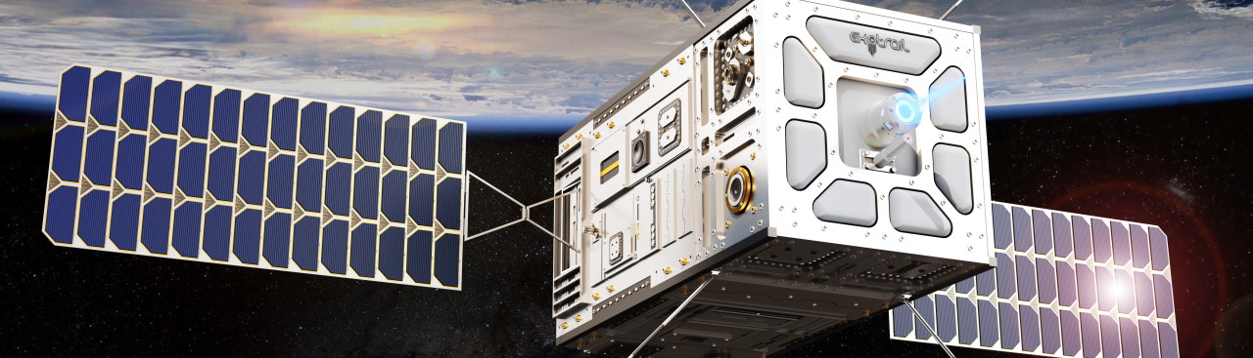
Conclusions
WarpX competitive with existing codes and a good fit for Hall thruster simulation
Resampling should be applied carefully
Results not very sensitive to field solve precision
GPU-based codes can do a lot with little hardware
Advancements in GPU hardware making kinetic simulations more tractable
Our code is public, available at https://github.com/archermarx/warpx-hall

Slide 40



Acknowledgements
Los Alamos National Laboratory
Air Force Office of Scientific Research
Advanced Research Computing at the University of Michigan

Slide 41
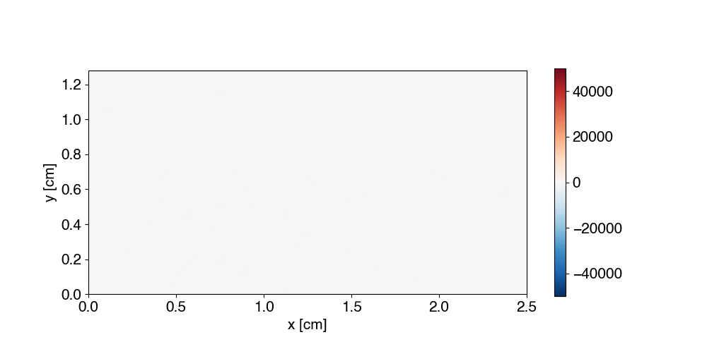
Questions?
Azimuthal electric field [V/m]

